Slide 1
NetWorking with Wireshark
Unit 5.2
Cybersecurity Boot Camp |

Slide 2

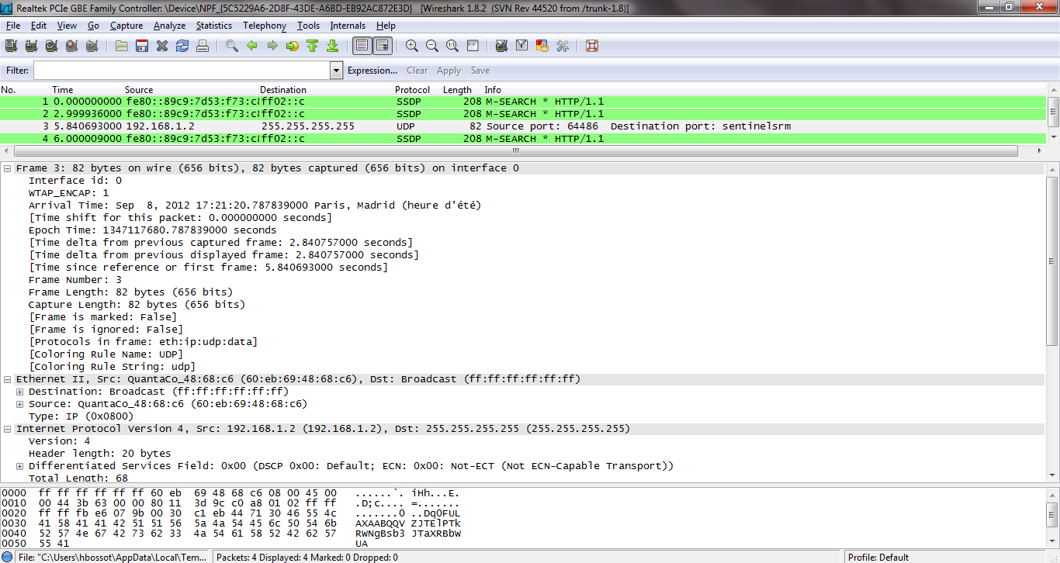

This Week on Cybersecurity…
Networking, Wireshark
Notes:
Talk about what’s upcoming this week

Slide 3
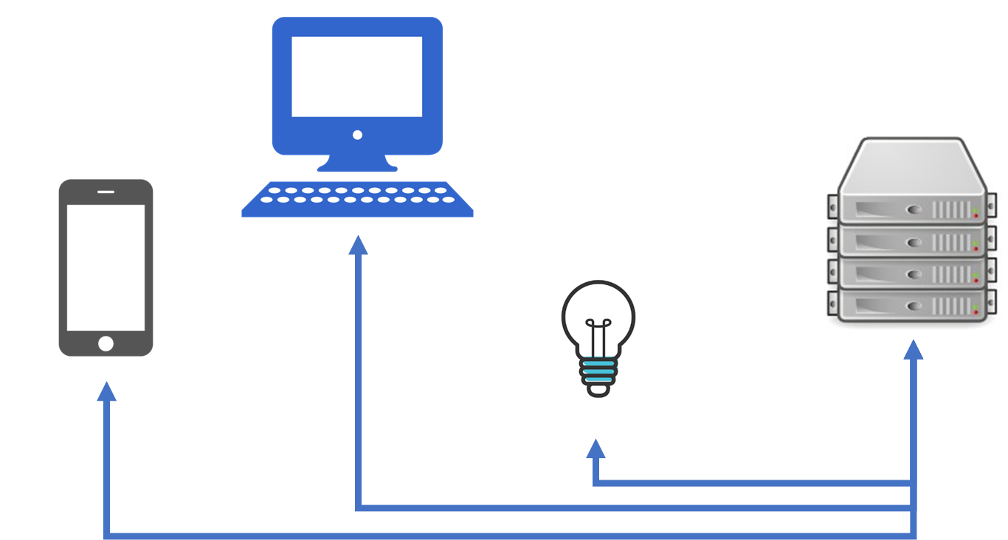
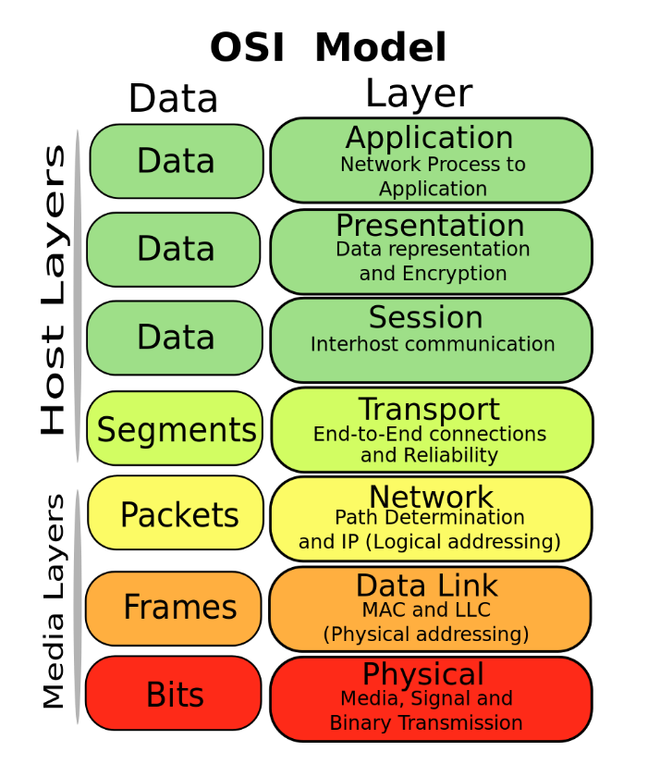
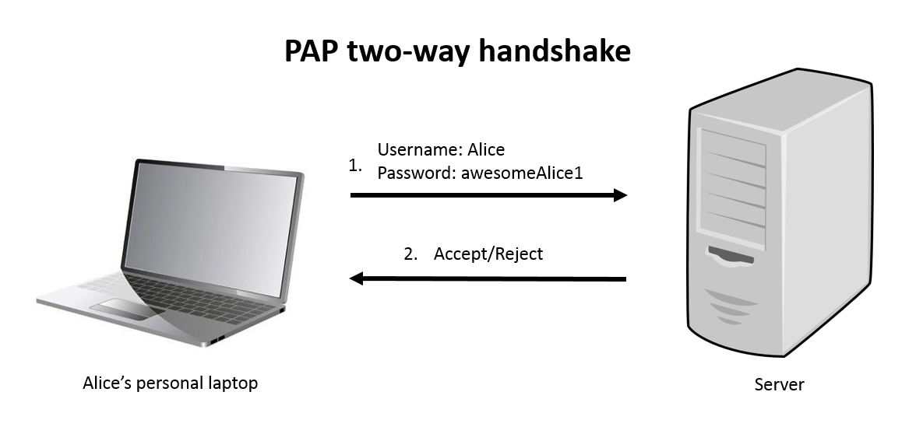
Last Class
Networking, Protocols, OSI Model
Notes:
Talk about what’s upcoming this week

Slide 4

Today
Wireshark, Packet Analysis
Notes:
Talk about what’s upcoming this week

Slide 5
Today’s Goals
By the end of class, you will be able to:
Explain the purpose and value of tools like Wireshark in cybersecurity
Capture communication over the network using Wireshark
Explain the basics of a packet in Wireshark
Analyze existing packet capture files using Wireshark
Filter packet capture files to only show specific communication using Wireshark
Associate functionality in Wireshark with the OSI Model
Explain the various panels/views in Wireshark and the contents displayed
Notes:
But today, we’re going to… Review goals, address questions.

Slide 6
Today’s Goals
Today is primarily about getting comfortable with Wireshark.
Notes:
But today, we’re going to… Review goals, address questions.

Slide 7
Wireshark Basics

Slide 8

Wireshark
What is it?
Wireshark is a packet analysis tool.
It is used by industry professionals to monitor and dissect network traffic.
We can use it see request/response cycles, protocol information, bits transferred, and more…

Slide 9
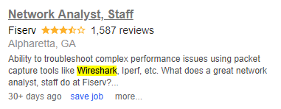
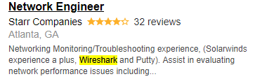

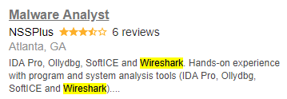
Wireshark
Who uses it?
Over 500,000 downloads per month – used by industry professionals everywhere.
It is used in a variety of roles for troubleshooting and monitoring.
Notes:
https://www.indeed.com/jobs?q=wireshark&l=Atlanta%2C+GA

Slide 10
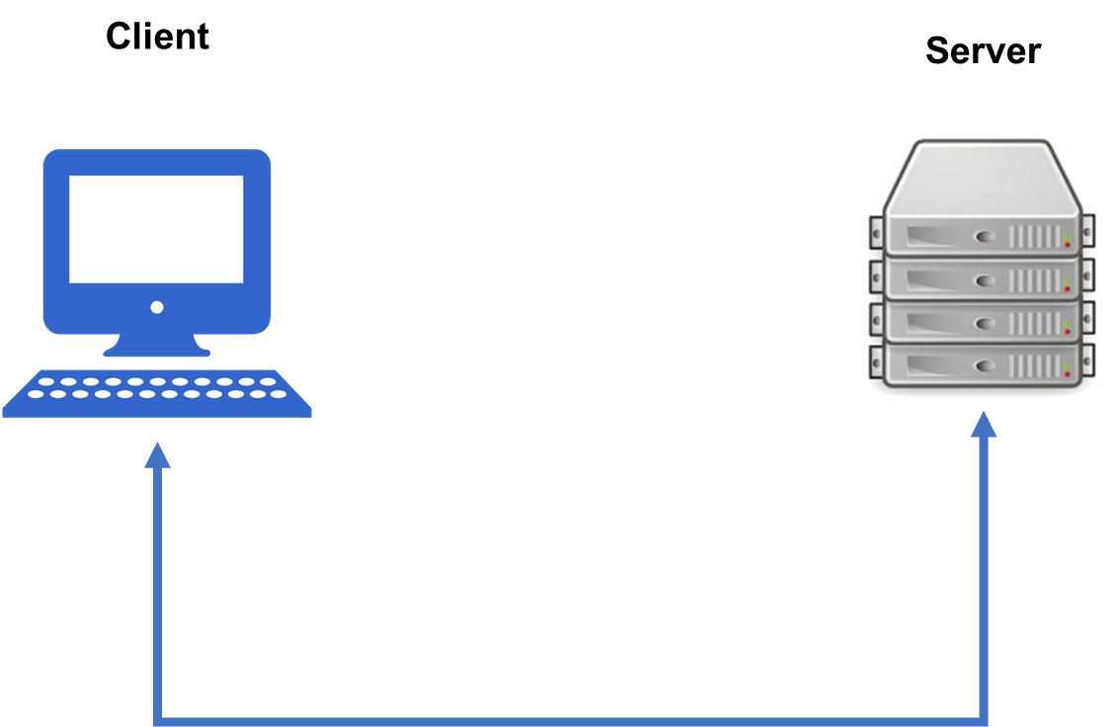
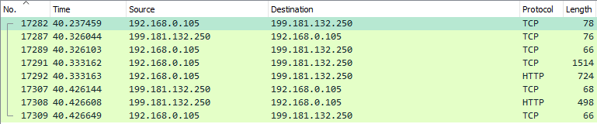
Wireshark
Why now?
Wireshark allows us to see real traffic across the network, instead of keeping everything conceptual.
Notes:
https://www.indeed.com/jobs?q=wireshark&l=Atlanta%2C+GA

Slide 11
Wireshark
With Wireshark we can dive into network communication and start to pick apart the pieces

Slide 12

Wireshark
We can’t see everyone’s traffic though.
Typical network devices transmit data only to the relevant computers communicating, not to all devices.
We’ll talk about how to view other traffic in the future, but for now we’ll stick to our own.
Notes:
No, we can’t! Typical networks only send packets between your devices and other devices, so you can’t see

Slide 13
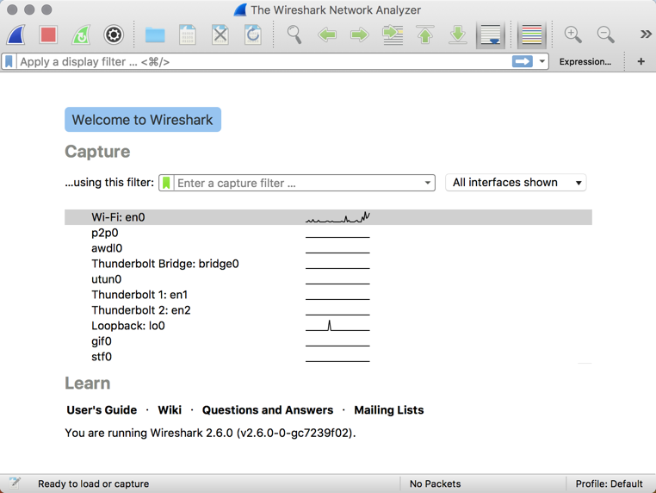
Activity: Install Wireshark Check (5 min)
Instructions:
Visit the Wireshark website (https://www.wireshark.org/) and proceed to download the application.
Follow the steps through the installation process. (Windows users: Be sure to "Select All" when prompted to "Select Components to Install").
Once installed, open the application. You should see a view that looks like this:
Bonus:
Navigate to the Wireshark User Guide and begin skimming through the first few chapters.
Start and stop a capture. See if you can find in the UI the “0s and 1s”, and also any recognizable communication.

Slide 14
First things first…
Before we really dive in with the shark, let’s talk about…
Notes:
But today, we’re going to… Review goals, address questions.

Slide 15
Packets

Slide 16
Packets
Great, Wireshark shows us packets! …What is a packet?
Packet Example - Email
Header | Sender’s IP Address, Receiver’s IP Address, Protocol, … | 96 bits
Payload | Data | 660 bits
Trailer | Indicate end of packet, error correction | 32 bits
Packets are pieces of data sent over the network – chunks of data including source, destination, and the content (e.g. email).
Notes:
But today, we’re going to… Review goals, address questions.

Slide 17
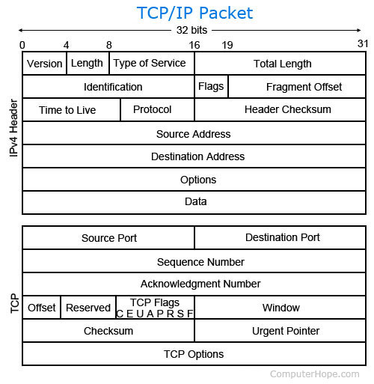
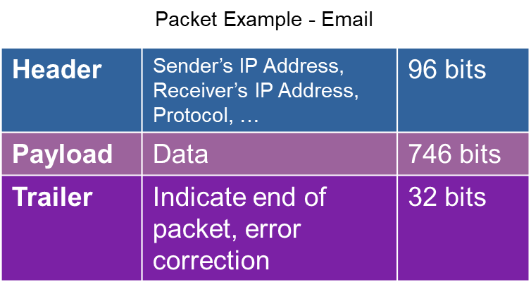
Packets
Packets include a ton of information, but we’ll dissect them over time (not all right now).
Notes:
But today, we’re going to… Review goals, address questions.

Slide 18
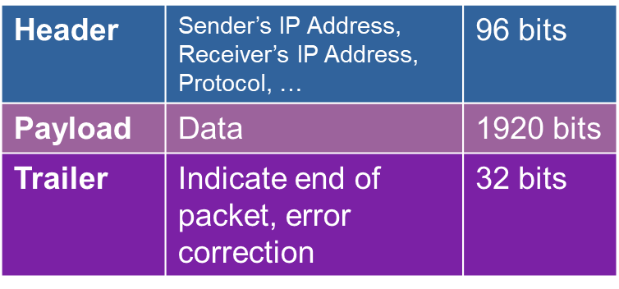
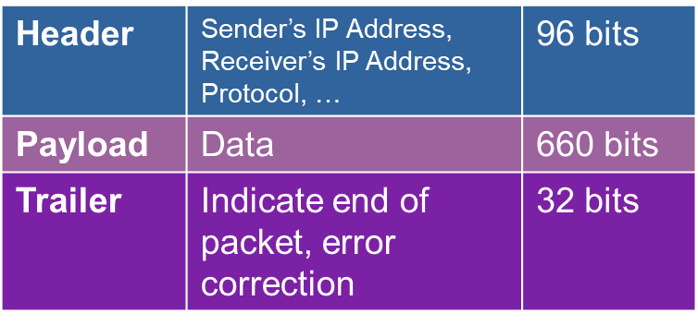
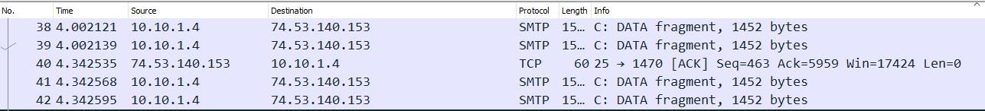
Message -> Packets -> Message
It often takes multiple packets to communicate a whole message. If your network uses fixed-length packets of 2 kb (2048 bits), then a 4500 kb message would be split into 3 packets:
1
2
3
4 packets all part of the same email
Notes:
The good thing about this is that if a single packet gets corrupted or lost, only that packet needs to be resent.

Slide 19
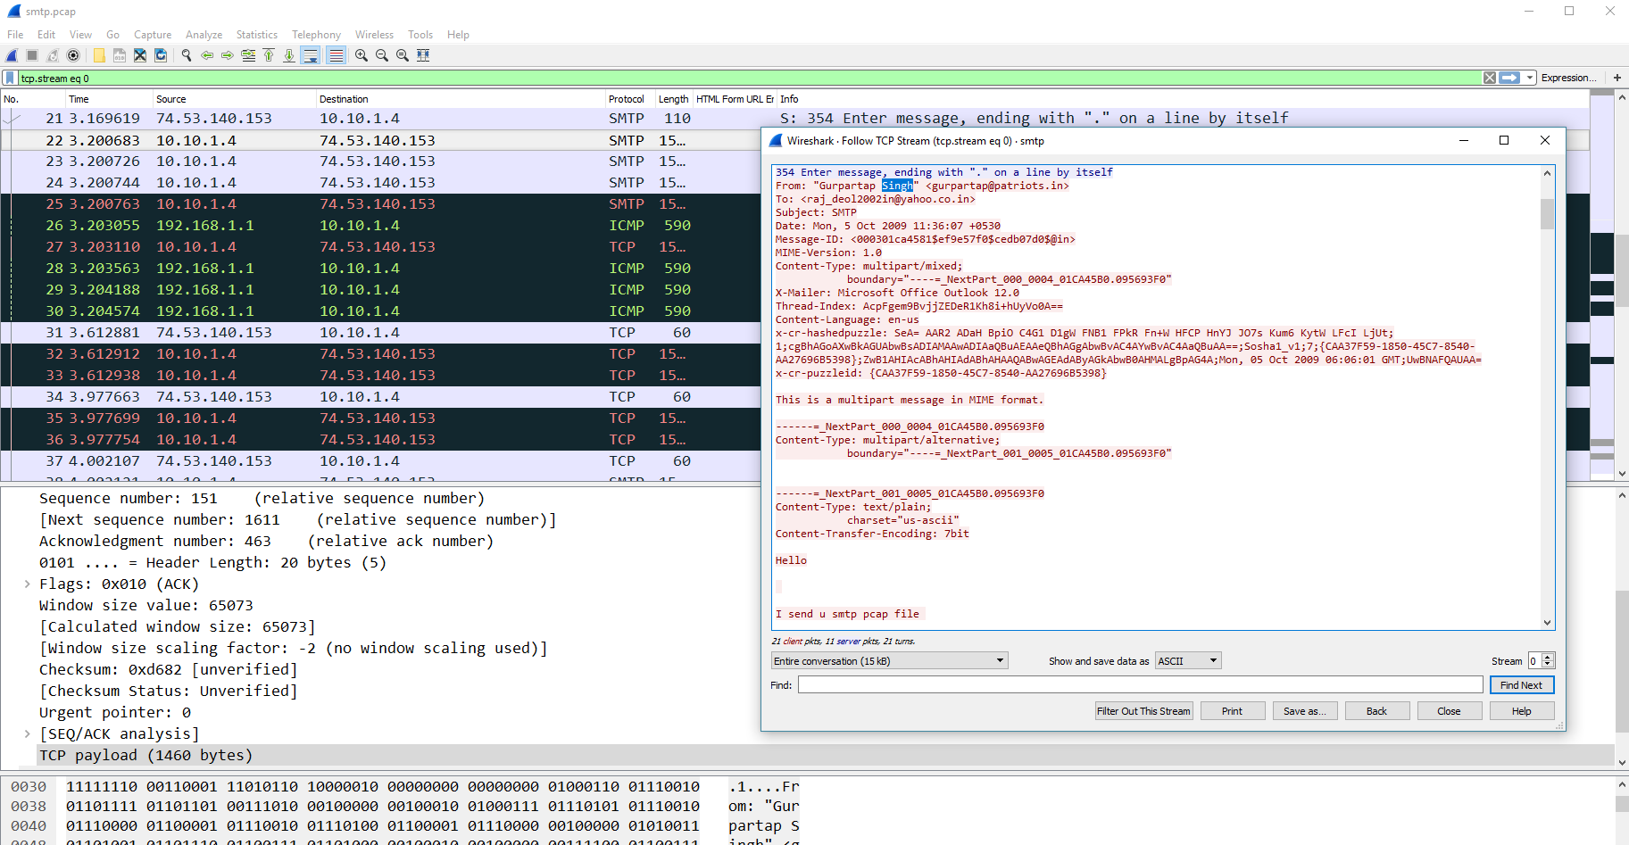
Packets in Wireshark
In Wireshark, we can see information about packets sent over the network, and their associated data.
Notes:
But today, we’re going to… Review goals, address questions.

Slide 20
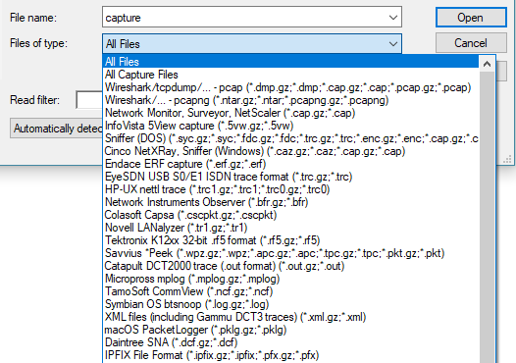
PCAPs – Packet Captures
A Packet Capture file is a sequence of packets captured while listening to traffic across the network.
Wireshark can capture network traffic to create packet capture files, and it can also read them.
Common extensions:
.cap
.pcap
.pcapng
Notes:
But today, we’re going to… Review goals, address questions.

Slide 21
Activity: Diving with the Wiresharks (15 min)
In this activity, you’ll conduct a capture and investigate a packet capture file and answer a series of questions about the traffic in the file.
Instructions:
Open up Wireshark and follow the instructions sent to you, answering questions as you come across them.

Slide 22
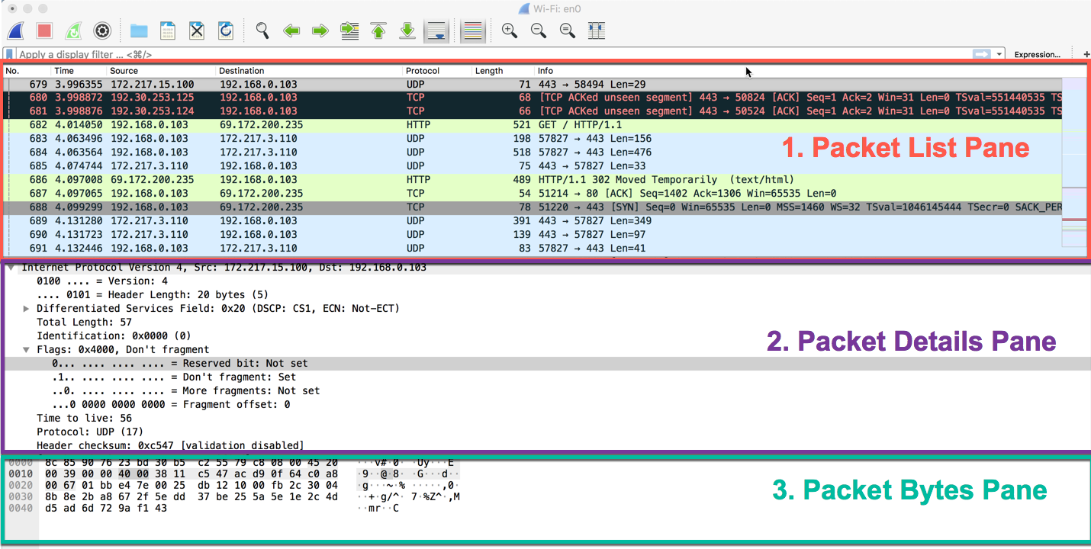
Review Diving with the Wiresharks

Slide 23
Activity: My First Sniff (10 min)
Instructions:
Spend a few moments identifying a website that is not secured through HTTPS.
As a suggestion, visit the whynohttps website (https://whynohttps.com/). While some have since been secured, many remain insecure.
Start a Wireshark capture and visit one of these pages. Stop the capture after a few moments and answer the following questions:
Which packets are relevant to your web browsing?
Which packets are relevant to your machine's request?
Which packets are relevant to the website's response?
If you are seeing many rows of requests and responses, why might this be the case?
Which packets contain the HTML markup of the website? (Hint: The packet should show text similar to what you see on the webpage.)
If you finish early, re-attempt this experiment, but this time use a website that *is* secure. What do you see this time? What might be the significance of HTTPS vs HTTP?

Slide 24
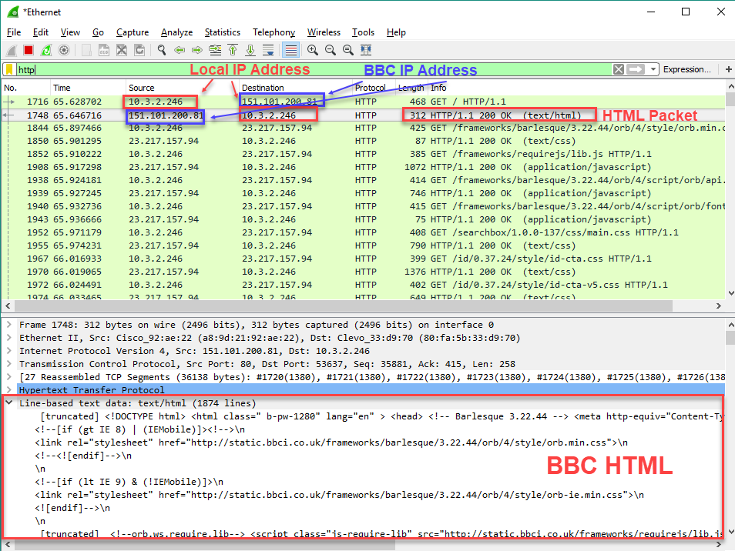
Review My First Sniff

Slide 25
Break (15 min)

Slide 26
Activity: Leaky HTTP Traffic (10 min)
In this activity, you’ll use Wireshark to retrieve a user’s username and password being communicated through an insecure website
Instructions:
Initiate a Wireshark capture.
Open a Chrome window using incognito mode (`Ctrl+Shift+N` or `Cmd+Shift+N`).
Navigate to the webpage www.aavtrain.com. Attempt to login using a dummy username and password.
Return to your Wireshark window and stop the capture.
See if you can identify the packet relevant to your form submission. (Hint: A GET request is when you request information from a server. A POST request is when...)
Once you identify the relevant row, see if you can extract from the packet data the username and password you entered.
Turn to the internet and the person next to you to speculate as to how this plaintext password communication can be avoided (hint: HTTPs)

Slide 27
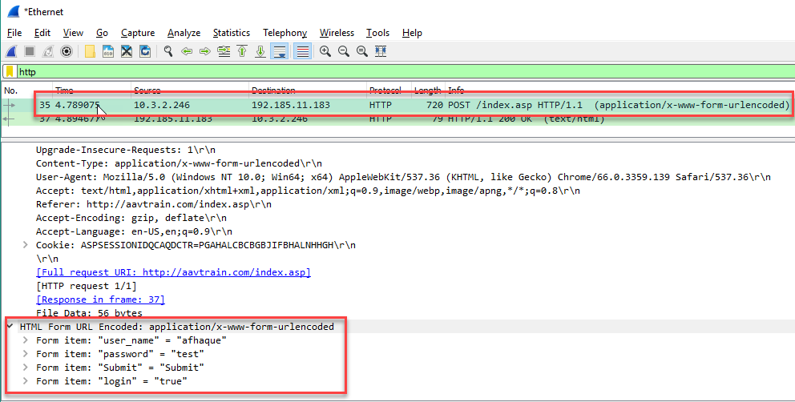
Review Leaky HTTP Traffic

Slide 28
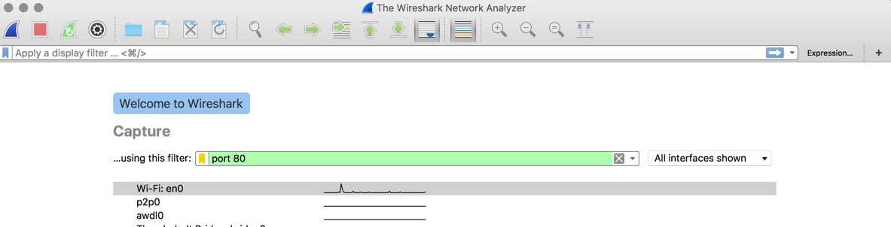
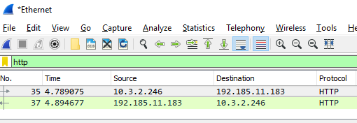
Capture & Display Filters
Instructor Demo
Capture Filter
Display Filter

Slide 29
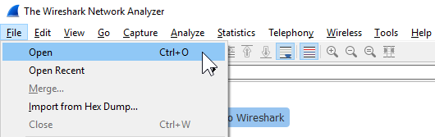
Activity: The Search for Something Cool (15 min)
In this activity, you’ll import a pcap file and try to retrace a user’s browsing history.
Instructions:
Open up the provided file with Wireshark and complete the instructions sent to you.

Slide 30
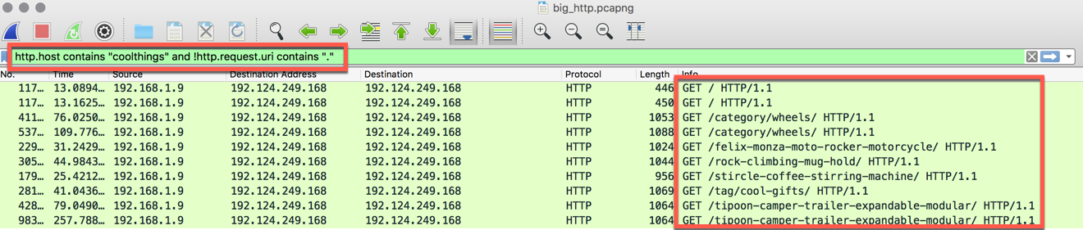
Review The Search for Something Cool

Slide 31
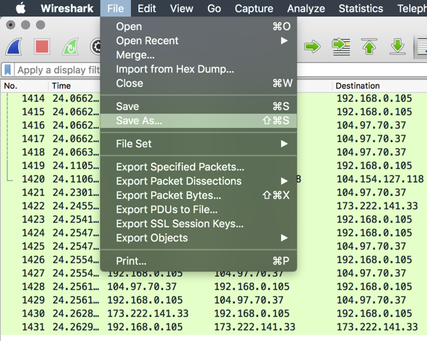
PCAP Exports
Instructor Demo

Slide 32
Activity: Sifting the Haystack (15 min)
In this activity, you’ll capture some traffic, share the file with your partner, and then try to determine which websites and pages they visited!
Instructions:
Initiate a Wireshark capture.
While the capture is running, visit the pages: http://meettheipsums.com/ and http://www.coolthings.com/ one after the other.
Next, visit the pages http://www.espn.com and http://www.foxnews.com and begin selecting articles on each site. In your head, keep track of the articles you visit.
Stop the capture and export it into a pcap file. Share this file with a partner.
Once you receive your partner's pcap file, see if you can ascertain the order of their browsing history, and which articles they visited.
Hint:
Use this as an opportunity to explore new and relevant filters using the documentation: https://www.wireshark.org/docs/wsug_html_chunked/ChWorkBuildDisplayFilterSection.html

Slide 33
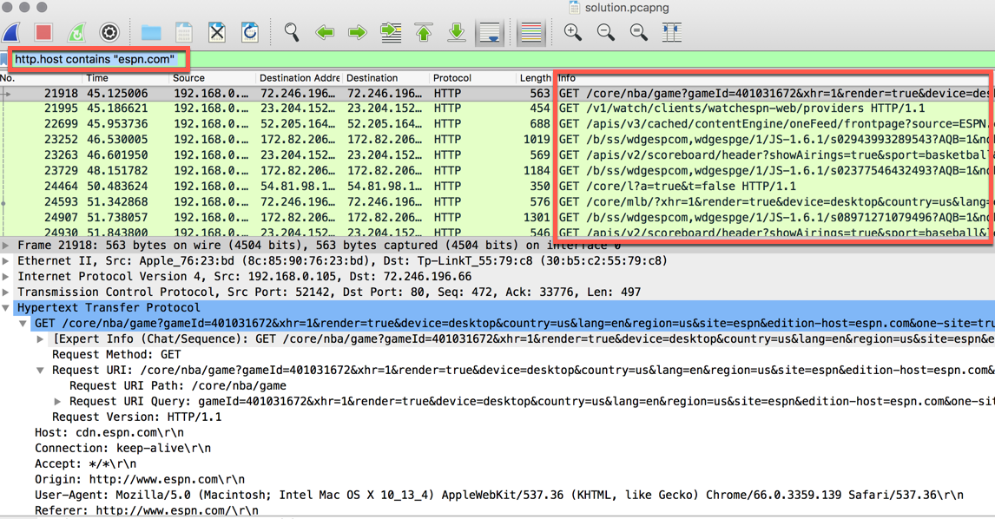
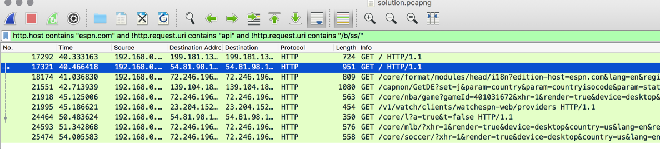
Review Sifting the Haystack

Slide 34
Lesson Recap (10 min)

Slide 35
Today’s Goals
By the end of class, you will be able to:
Explain the purpose and value of tools like Wireshark in cybersecurity
Capture communication over the network using Wireshark
Explain the basics of a packet in Wireshark
Analyze existing packet capture files using Wireshark
Filter packet capture files to only show specific communication using Wireshark
Associate functionality in Wireshark with the OSI Model
Explain the various panels/views in Wireshark and the contents displayed
Notes:
But today, we’re going to… Review goals, address questions.

Slide 36
Homework
3 Parts:
Dissecting Mystery PCAPs
Homework Network Analysis
(Bonus) File Carving

Slide 37
Resources
Packet Basics
Data Packet Deep Dive
Wireshark Documentation

